Slide 1





QUAC-TRNG High-Throughput True Random Number Generation Using Quadruple Row Activation in Real DRAM Chips
Ataberk Olgun
Minesh Patel A. Giray Yağlıkçı Haocong Luo
Jeremie S. Kim F. Nisa Bostancı Nandita Vijaykumar
Oğuz Ergin Onur Mutlu

Slide 2
Executive Summary
Motivation: DRAM-based true random number generators (TRNGs) provide true random numbers at low cost on a wide range of computing systems
Problem: Prior DRAM-based TRNGs are slow:
Based on fundamentally slow processes → high latency
Cannot effectively harness entropy from DRAM rows → low throughput
Goal: Develop a high-throughput and low-latency TRNG that uses commodity DRAM devices
Key Observation: Carefully engineered sequence of DRAM commands can activate four DRAM rows → QUadruple ACtivation (QUAC)
Key Idea: Use QUAC to activate DRAM rows that are initialized with conflicting data (e.g., two ‘1’s and two ‘0’s) to generate random values
QUAC-TRNG: DRAM-based TRNG that generates true random numbers at high-throughput and low-latency by repeatedly performing QUAC operations
Results: We evaluate QUAC-TRNG using 136 real DDR4 chips
5.4 Gb/s maximum (3.4 Gb/s average) TRNG throughput per DRAM channel
Outperforms existing DRAM-based TRNGs by 15.08x (base), and 1.41x (enhanced)
Low TRNG latency: 256-bit RN in 274 ns
Passes all 15 NIST randomness tests

Slide 3
Outline
True Random Numbers in DRAM
DRAM Organization and Operation
QUadruple ACtivation (QUAC)
QUAC-TRNG
Evaluation

Slide 4

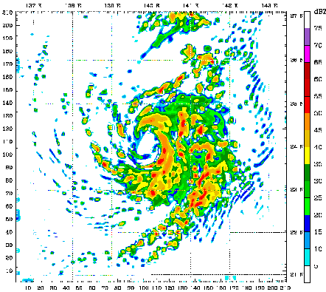
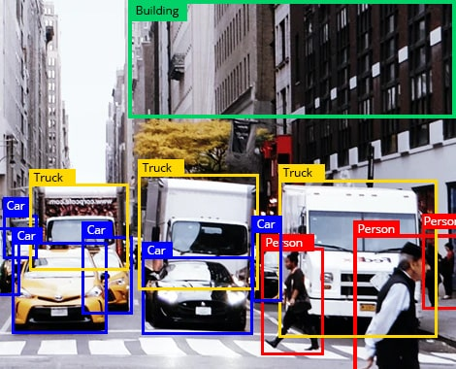
Use Cases of True Random Numbers
High-quality true random numbers are critical to many applications
True random numbers can only be obtained by sampling random physical processes
Unfortunately, not all computing systems are equipped with TRNG hardware (e.g., dedicated circuitry)

Slide 5
DRAM-Based TRNGs
DRAM chips are ubiquitous in modern computing platforms
DRAM-based TRNGs enable true random number generation within DRAM chips
Low-cost: No specialized circuitry for RNG
Beneficial for constrained systems
High-throughput: > Gb/s throughput
Open application space that require high-throughput TRNG

Slide 6


Synergy with Processing-in-Memory
Processing-in-Memory (PIM) Systems
Perform computation directly within a memory chip
Improve system performance by avoiding off-chip data movement
True random number generation within DRAM
Enables PIM workloads to sample true random numbers directly within the memory chip
Avoids inefficient communication to other possible off-chip TRNG sources, enhances security & privacy
[Samsung]
[UPMEM]

Slide 7
Outline
True Random Numbers in DRAM
DRAM Organization and Operation
QUadruple ACtivation (QUAC)
QUAC-TRNG
Evaluation

Slide 8
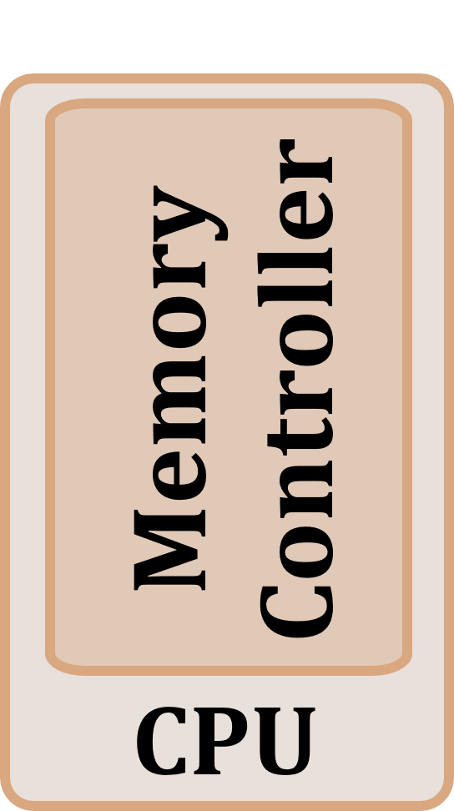
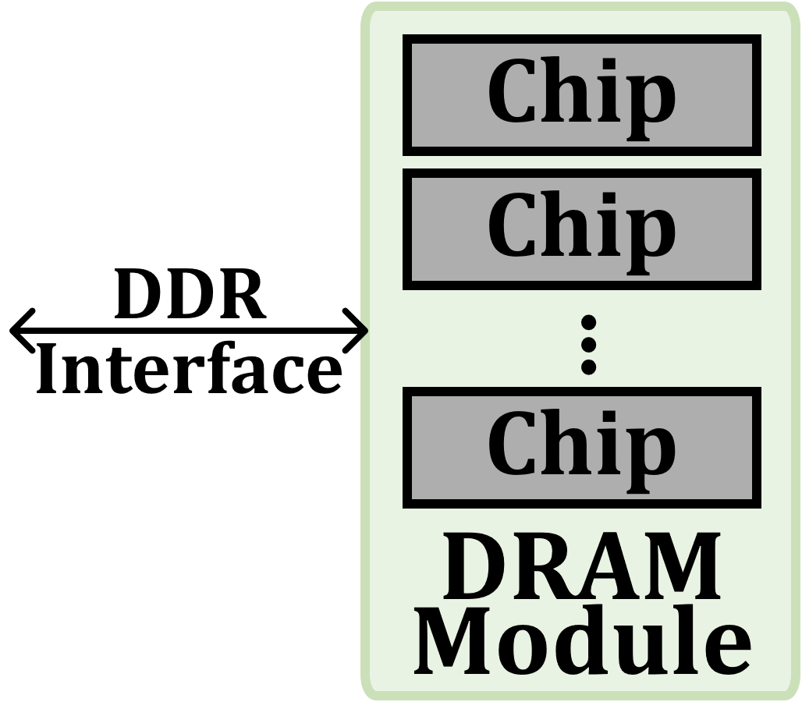
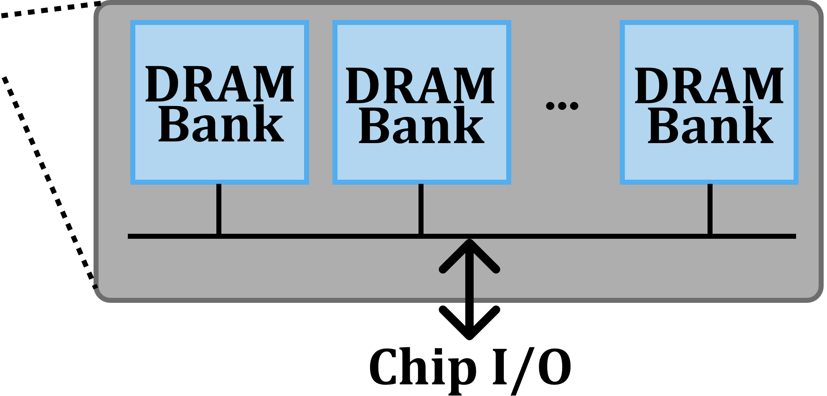
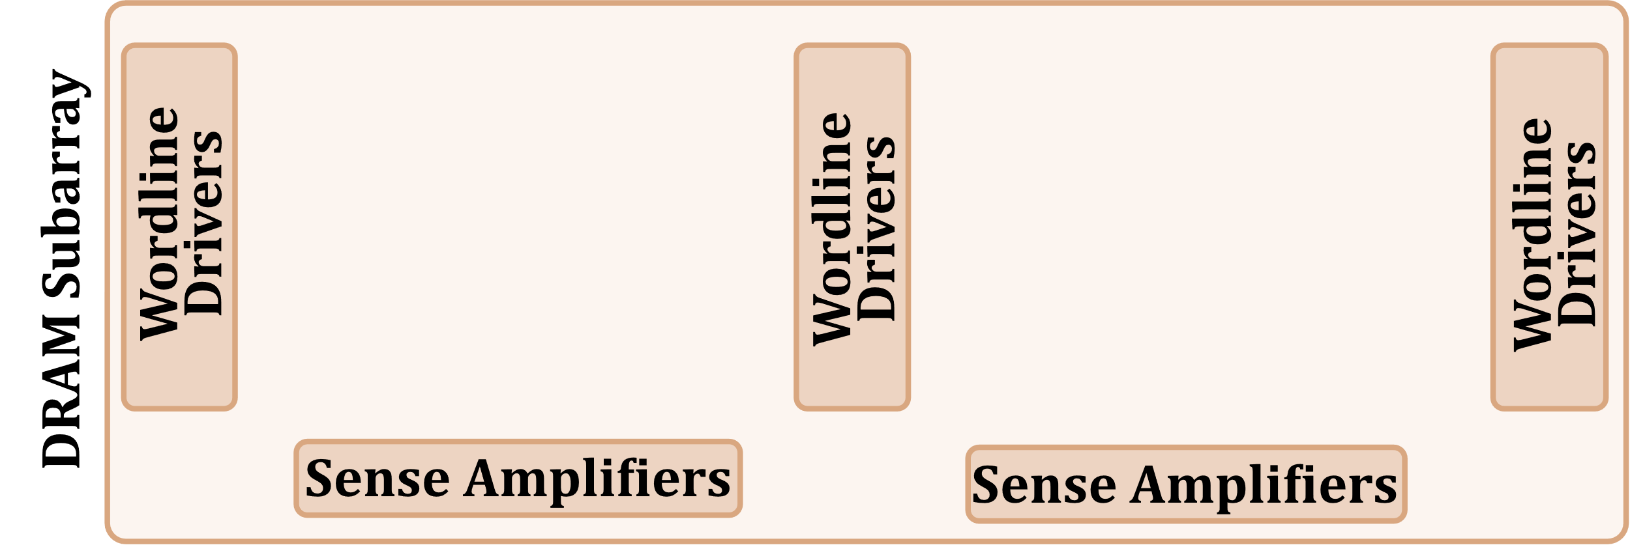
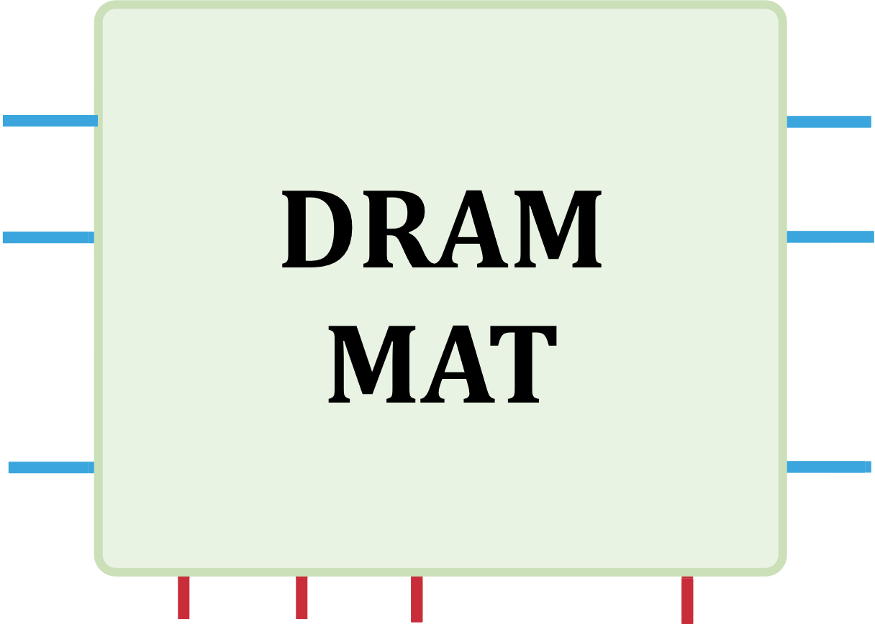
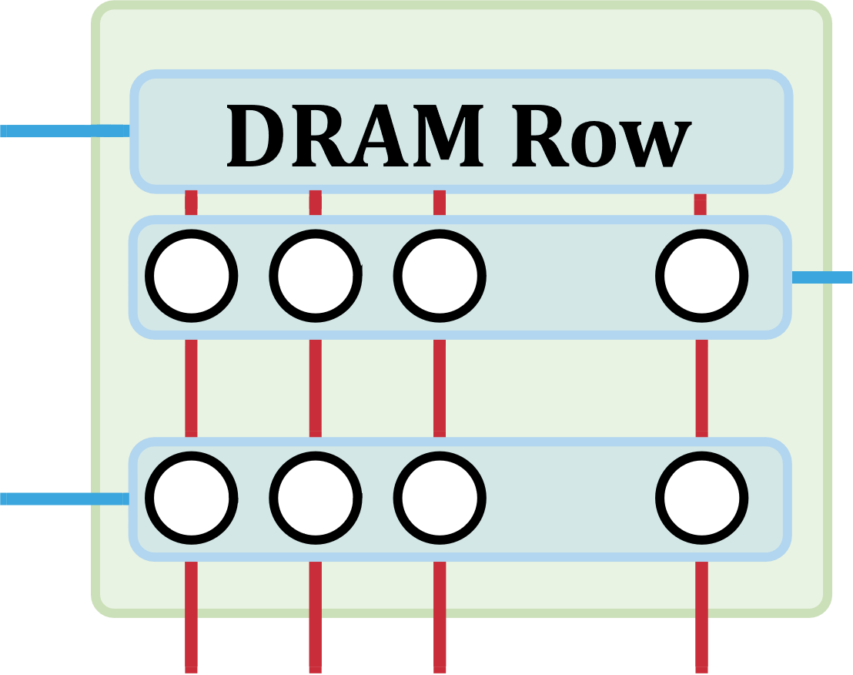
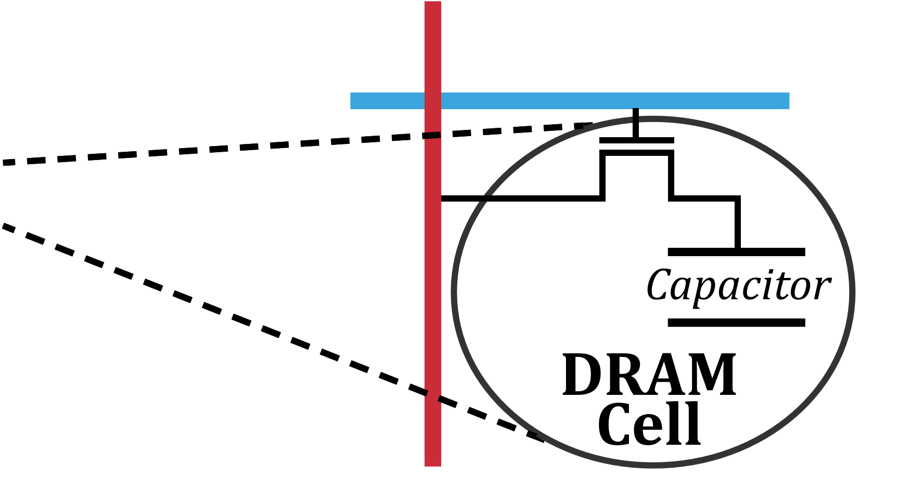
DRAM Organization
…
…
…

Slide 9
Accessing a DRAM Cell
wordline
capacitor
bitline
access transistor
Sense Amp
enable
bitline
[Seshadri+ MICRO’17]

Slide 10
Accessing a DRAM Cell
4
deviation in bitline voltage
enable wordline
wordline
1
½ V_{DD} + δ
V_{DD}
½ V_{DD}
capacitor
bitline
access transistor
2
connects cell to bitline
3
cell charge restored
cell loses charge to bitline
6
Sense Amp
enable sense amp
enable
5
bitline
½ V_{DD}
0
[Seshadri+ MICRO’17]

Slide 11
DRAM Operation
Cache line
…
Wordline Drivers
…
…
…
…
…
Sense Amplifiers
Sense Amplifiers
Sense Amplifiers
READ
READ
READ
READ
READ
READ
tRAS (Activation Latency)
tRP (Precharge Latency)
DRAM Command Sequence
ACT R0
RD
RD
RD
PRE R0
ACT R1
RD
RD
RD
time
[Kim+ HPCA’19]

Slide 12
Outline
True Random Numbers in DRAM
DRAM Organization and Operation
QUadruple ACtivation (QUAC)
QUAC-TRNG
Evaluation

Slide 13
Quadruple Activation (QUAC)
New Observation
Carefully-engineered DRAM commands can activate four rows in real DRAM chips
Activate four rows with two ACT commands
Violated
ACT
<3ns
PRE
<3ns
ACT
35ns
14ns
Default

Slide 14
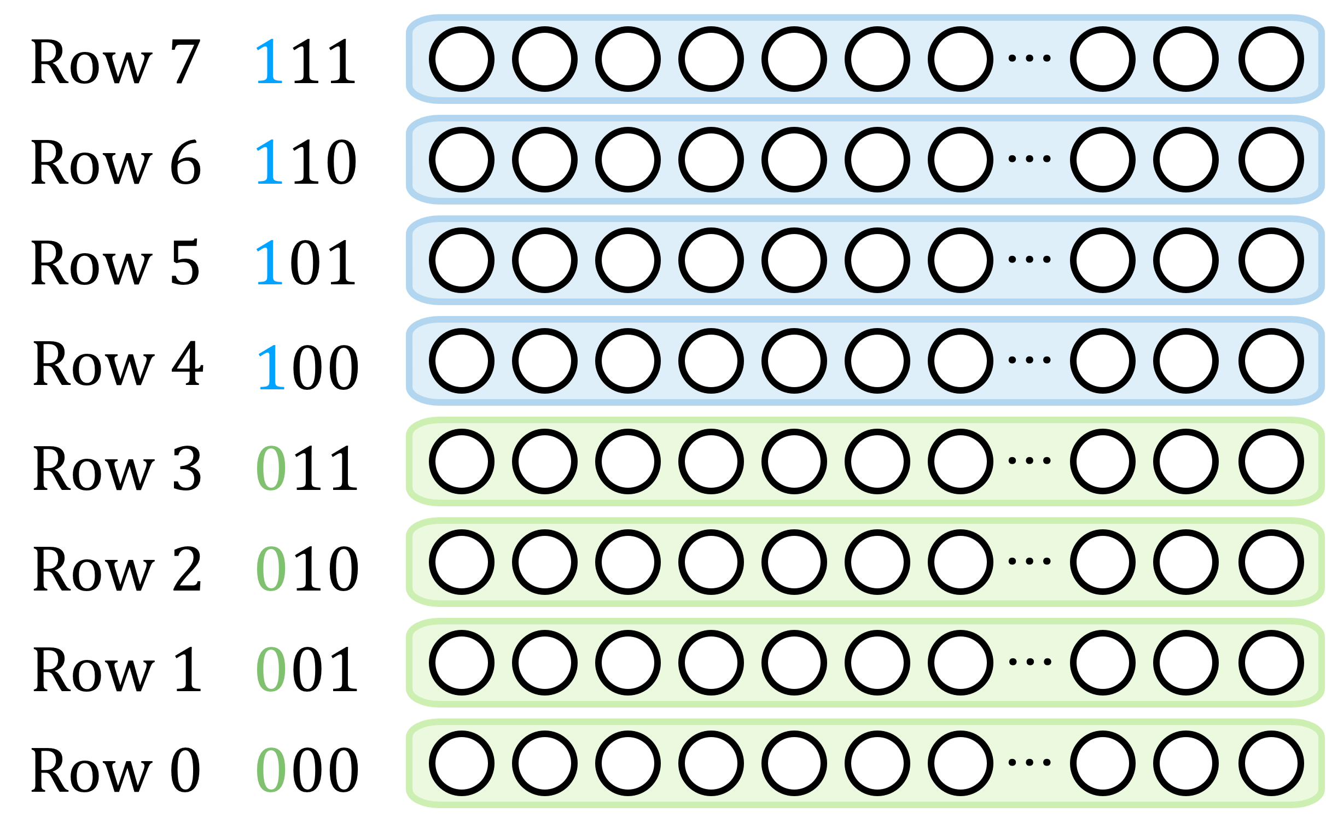
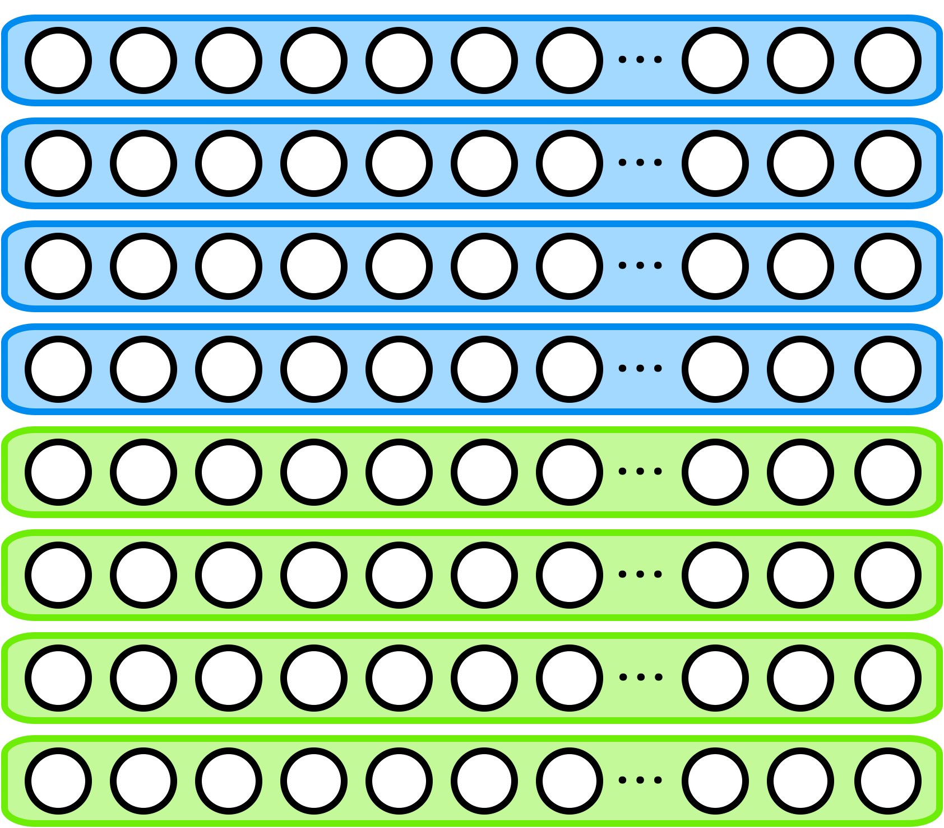


Quadruple Activation (QUAC)
Characteristic 1
Activates a set of four DRAM rows whose addresses differ only in their two LSBs

Slide 15
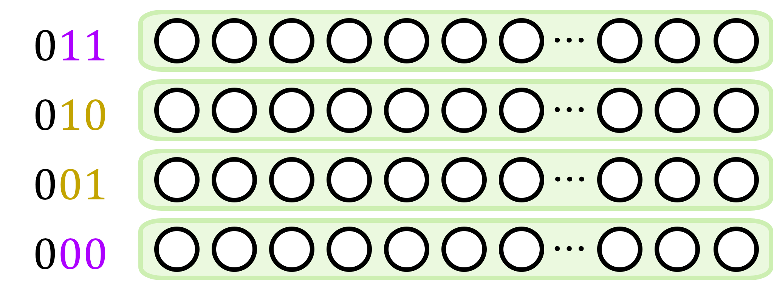
Quadruple Activation (QUAC)
Characteristic 2
First and second ACT’s addresses must have their two LSBs inverted
2
1
2
1
ACT 000
PRE
ACT 011
ACT 010
PRE
ACT 001

Slide 16
QUAC on Real DRAM Chips
Valid QUAC behavior on 136 DDR4 chips

Slide 17
Why Does QUAC Work?
Hypothetical circuit to explain QUAC
Hierarchical Wordlines
High density and performance requirements
Hierarchical organization of DRAM wordlines enable high-density and low-latency DRAM operation

Slide 18
Hierarchical Wordlines
A master wordline drives multiple local wordlines
…
…
…

Slide 19
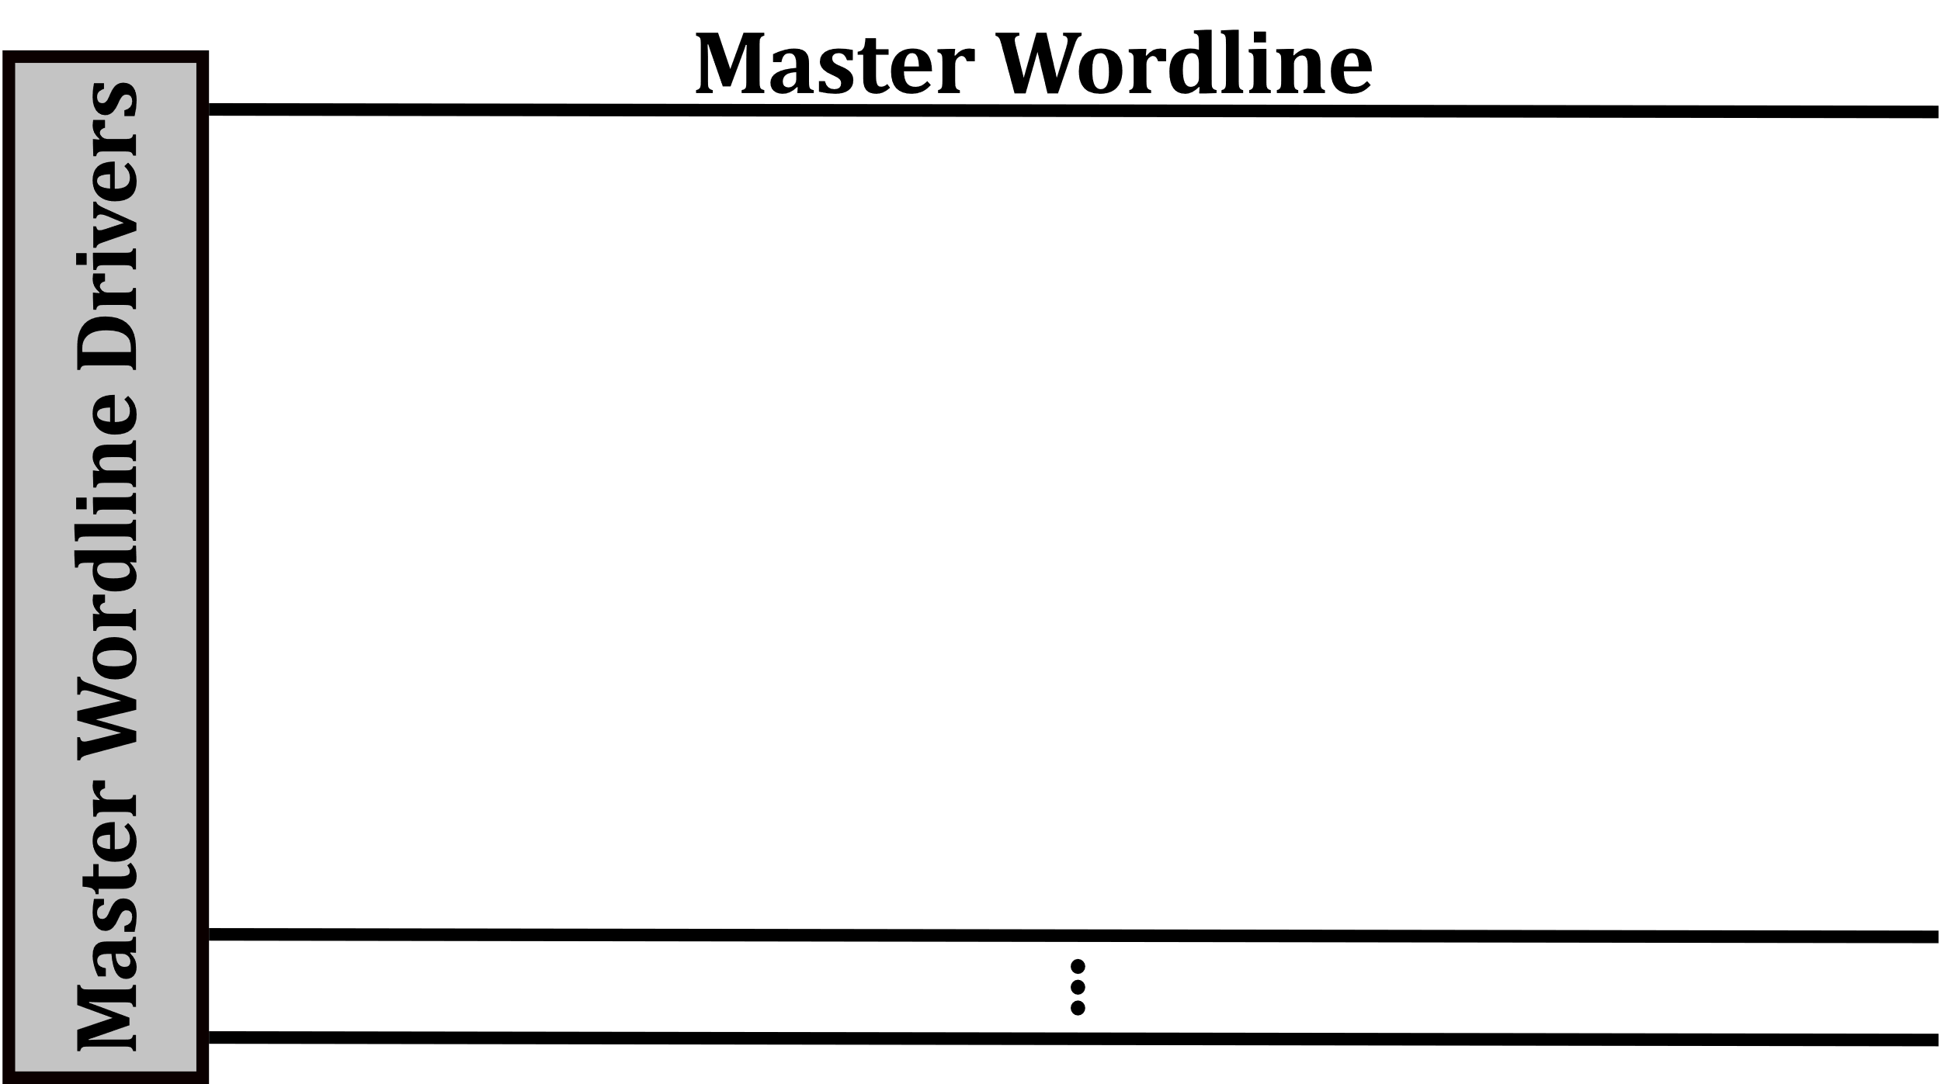
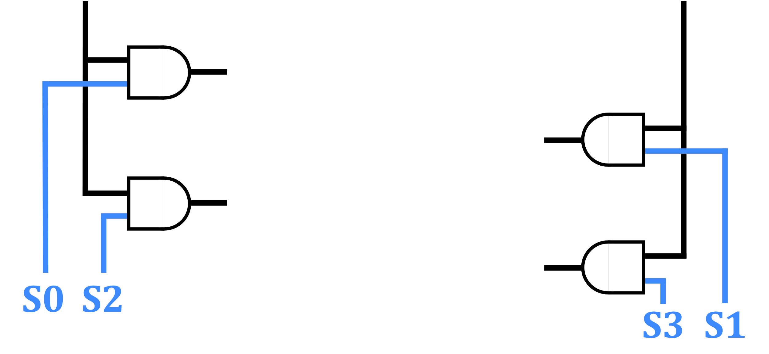
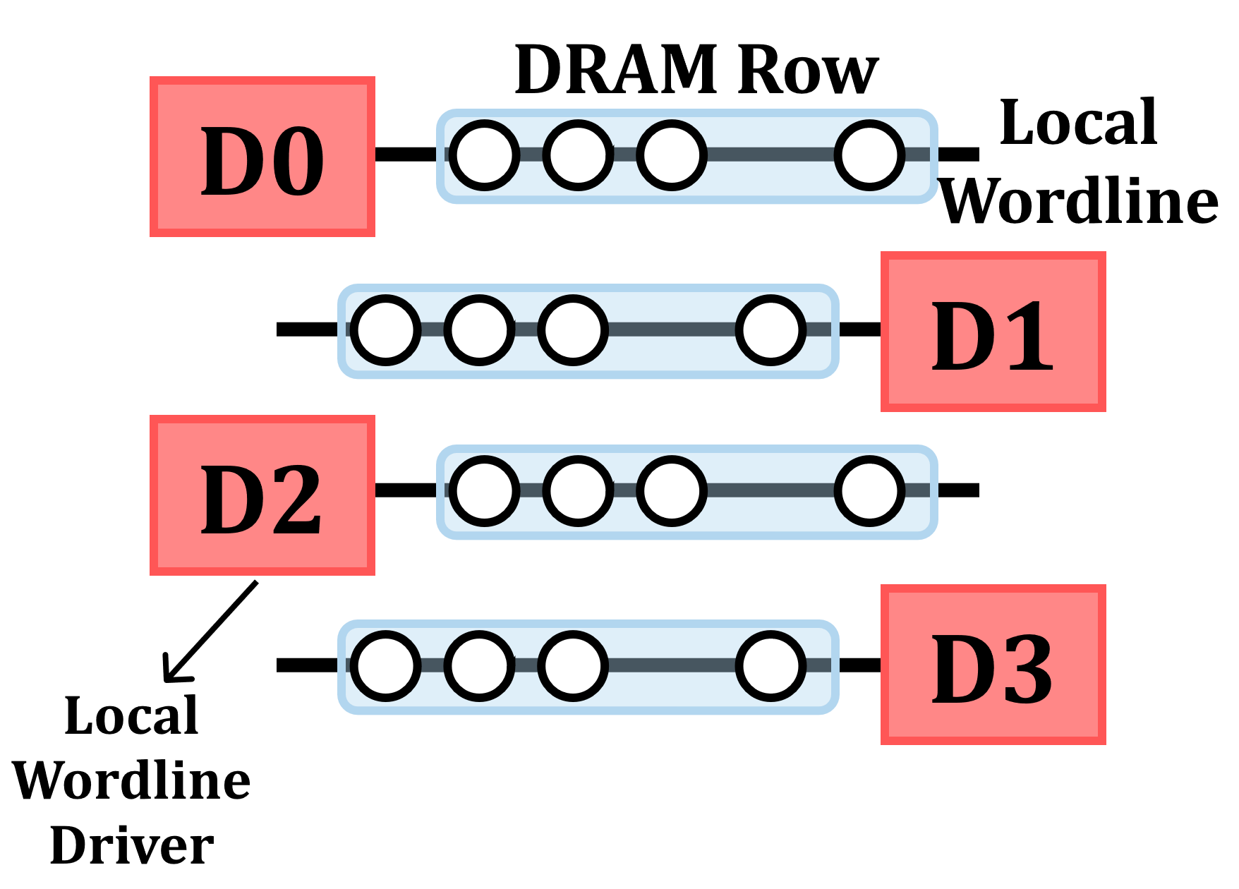
Hierarchical Wordlines
A master wordline drives multiple local wordlines
Select signals for rows 0-3

Slide 20
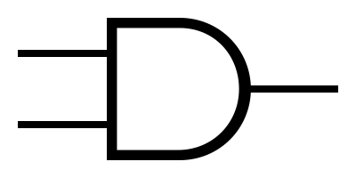
Hypothetical Row Decoder
Predecode the least significant two bits
Drive control signals
Latch
A0
S0
A1
Address [0]
L
A0
A0
S1
L
A0
A1
Address [1]
L
A1
A0
S2
A1
L
A1
A0
S3
A1

Slide 21
Hypothetical Row Decoder
Command
ACT R0
A0
S0
A1
0
L
A0
A0
S1
L
A0
A1
0
L
A1
A0
S2
A1
L
A1
A0
S3
A1
First ACT command drives a single wordline

Slide 22
Hypothetical Row Decoder
Command
ACT R0
Violate Timing
PRE
A0
S0
A1
0
L
A0
A0
S1
L
A0
A1
0
L
A1
A0
S2
A1
L
A1
A0
S3
A1
PRE command cannot disable latches

Slide 23
Hypothetical Row Decoder
Command
ACT R0
Violate Timing
PRE
Violate Timing
ACT R3
A0
S0
A1
1
L
0
A0
A0
S1
L
A0
A1
1
L
A0
0
A1
S2
A1
L
A1
A0
S3
A1
Second ACT drives the remaining three wordlines

Slide 24
Hypothetical Row Decoder
Command
ACT R0
Violate Timing
PRE
Violate Timing
ACT R3
A0
S0
A1
1
L
A0
A0
S1
L
A0
A1
1
L
A1
A0
S2
A1
L
A1
A0
S3
A1
All four wordlines are enabled
Quadruple Activation
Second ACT drives the remaining three wordlines

Slide 25
Outline
True Random Numbers in DRAM
DRAM Organization and Operation
QUadruple ACtivation (QUAC)
QUAC-TRNG
Evaluation

Slide 26
Generating Random Values via QUAC
V_{DD}/2
R3
V_{dd}
R2
V_{TH}
R1
0
Voltage Difference
Logic-1
R0
-V_{TH}
Ready to Sense
Voltage Level
Sense Amplifier
-V_{dd}
Enable
Time
V_{DD}/2

Slide 27
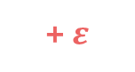
Generating Random Values via QUAC
V_{DD}/2
+ $ε$
R3
V_{dd}
R2
V_{TH}
R1
0
Voltage Difference
R0
-V_{TH}
Sense Amplifier
-V_{dd}
Enable
ACT R0
PRE
ACT R3
Time
V_{DD}/2

Slide 28
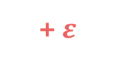
Generating Random Values via QUAC
V_{DD}/2
+ $ε$
R3
V_{dd}
Random perturbation
R2
V_{TH}
R1
0
Voltage Difference
R0
-V_{TH}
Sense Amplifier
-V_{dd}
Enable
ACT R0
PRE
ACT R3
Time
Enable Sense Amplifiers
V_{DD}/2

Slide 29
QUAC-TRNG
Key Idea: Leverage random values on sense amplifiers generated by QUAC operations as source of entropy
R3
R2
DRAM Segment
R1
R0
Sense Amplifiers
Step 1 Initialize
Step 2 QUAC
Random Values
Logic-1
Logic-0

Slide 30
QUAC-TRNG
Key Idea: Leverage random values on sense amplifiers generated by QUAC operations as source of entropy
256-bit Shannon Entropy Blocks
Sense Amplifiers
Memory Controller
SHA-256
256-bit TRN
Step 1 Initialize
Step 2 QUAC
Step 3 Read
Step 4 Post-process

Slide 31
QUAC-TRNG
Key Idea: Leverage random values on sense amplifiers generated by QUAC operations as source of entropy
Sense Amplifiers
Memory Controller
SHA-256
256-bit TRN
Generates a 256-bit random number for every 256-bit Shannon Entropy block
Step 1 Initialize
Step 2 QUAC
Step 3 Read
Step 4 Post-process

Slide 32
Outline
True Random Numbers in DRAM
DRAM Organization and Operation
QUadruple ACtivation (QUAC)
QUAC-TRNG
Evaluation

Slide 33
Real Chip Characterization
Experimentally study QUAC and QUAC-TRNG using 136 real DDR4 chips from SK Hynix
DDR4 SoftMC → DRAM Testing Infrastructure
[Hassan+ HPCA’17]
https://github.com/CMU-SAFARI/SoftMC

Slide 34
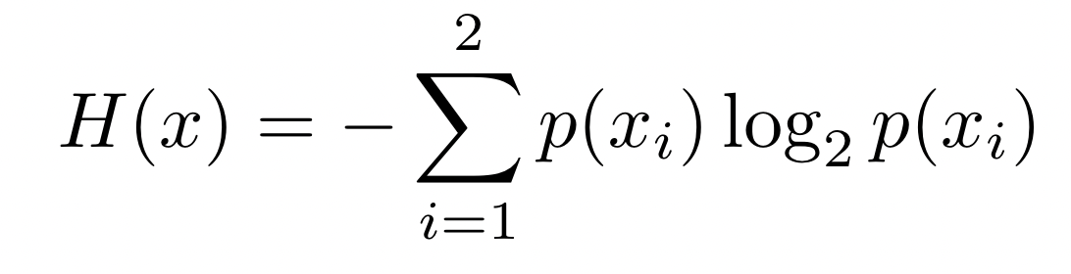
Real Chip Characterization
Measure randomness of bitstreams using Shannon Entropy
Sample each bitline following QUAC 1000 times and calculate the bitline’s Shannon Entropy
SE(1111…111) = 0
0 < SE(1001…010) < 1
Calculating probabilities:
Proportion of logic-1 and logic-0 values in the random bitstream

Slide 35
Real Chip Characterization
At 50°C and nominal voltage:
Repeatedly perform QUAC 1000 times and measure the Shannon Entropy of each bitline in
8K DRAM Segments (32K DRAM Rows),
using all 16 different four-bit data patterns
Data pattern: 1111 (four ones)
Data pattern: 1000
R3
R3
R2
R2
1111
1000
R1
R1
R0
R0

Slide 36
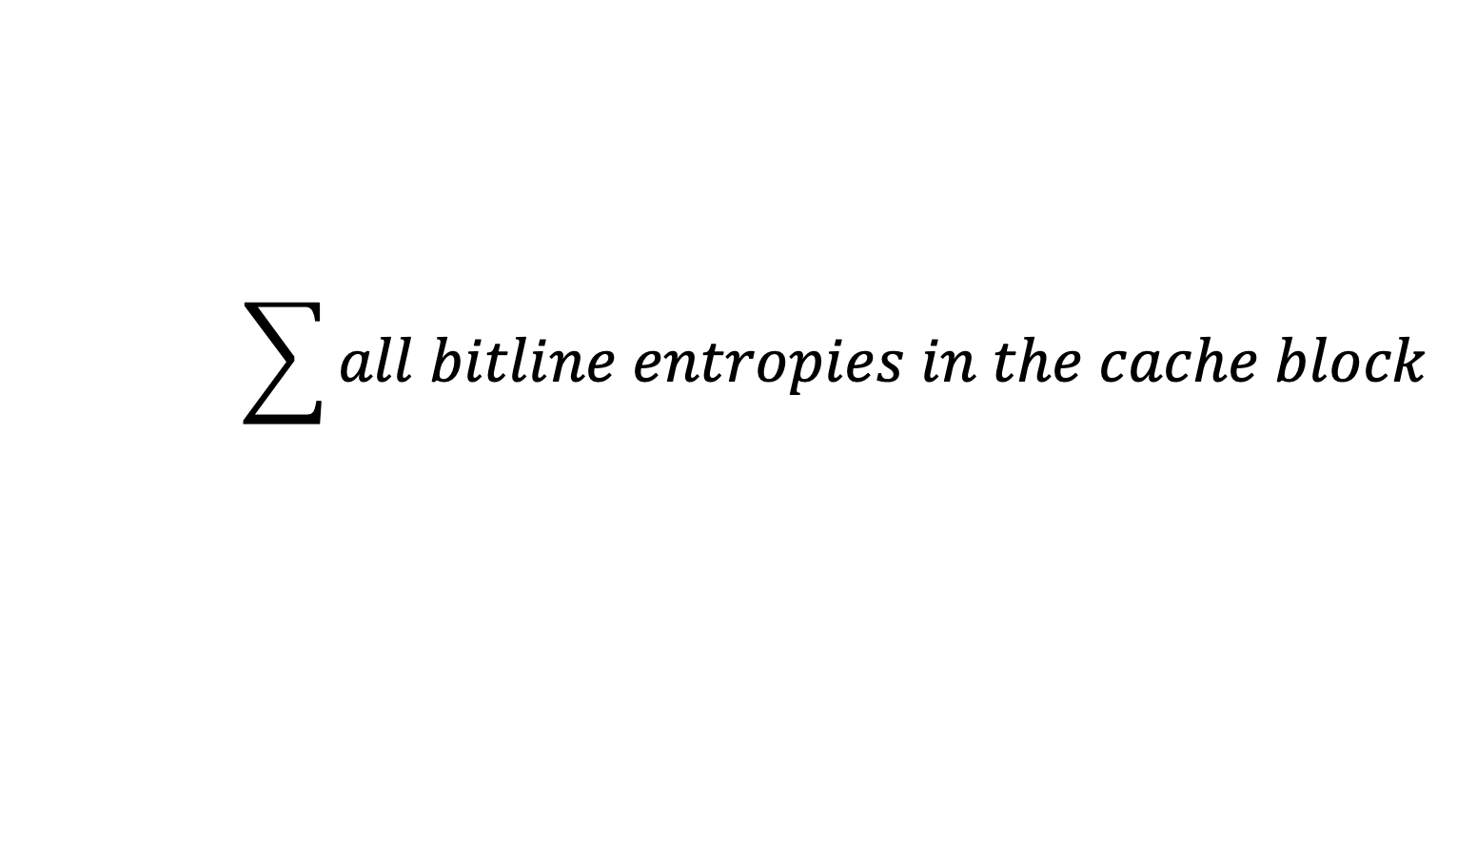
Data Pattern Dependence
Calculate cache block entropy (CBE)
Metrics based on CBE:
Average CBE: Average entropy across all cache blocks in a module
Maximum CBE: Maximum of the cache block entropies in a module
$$\sum{all bitline entropies in the cache block}$$

Slide 37
Data Pattern Dependence
Entropy varies with data pattern
Highest average entropy with pattern “0111”

Slide 38
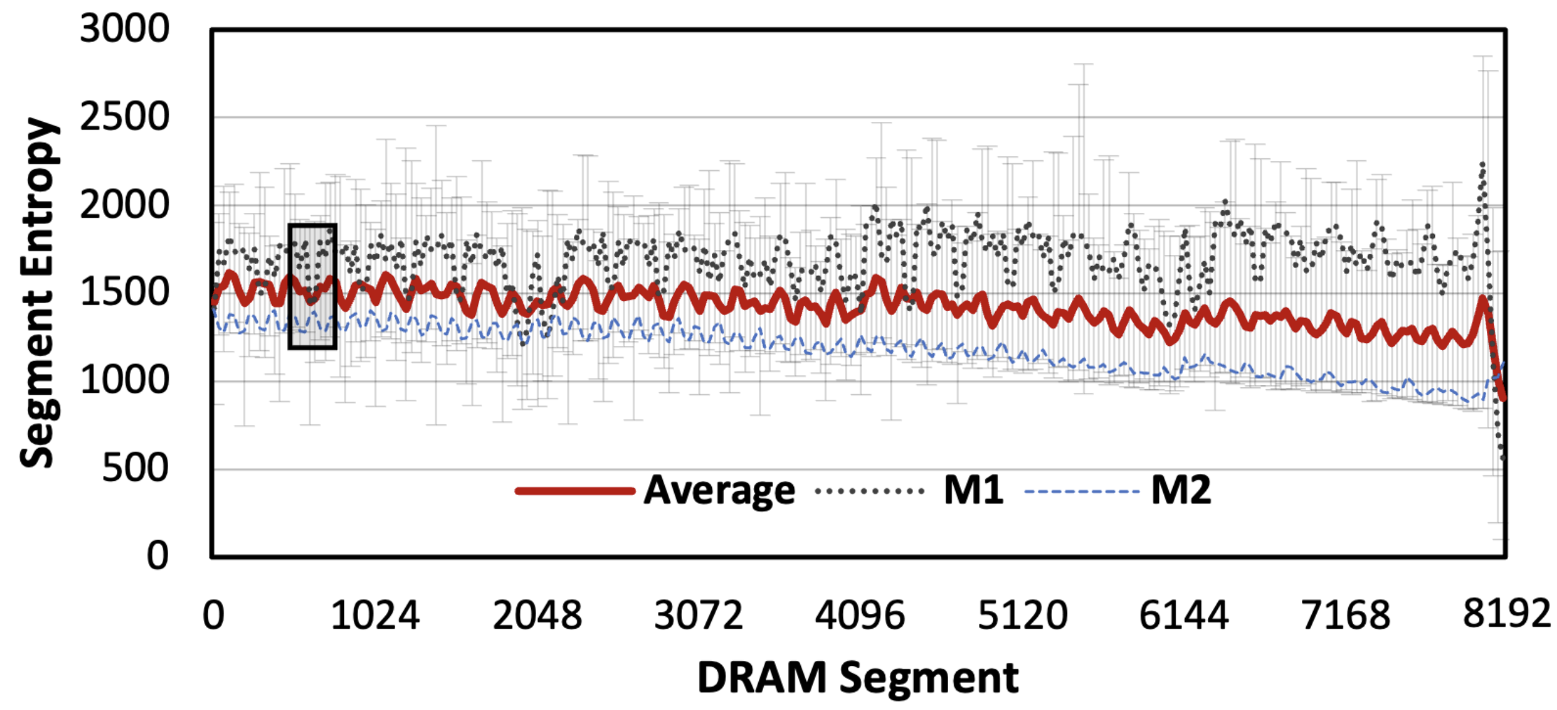
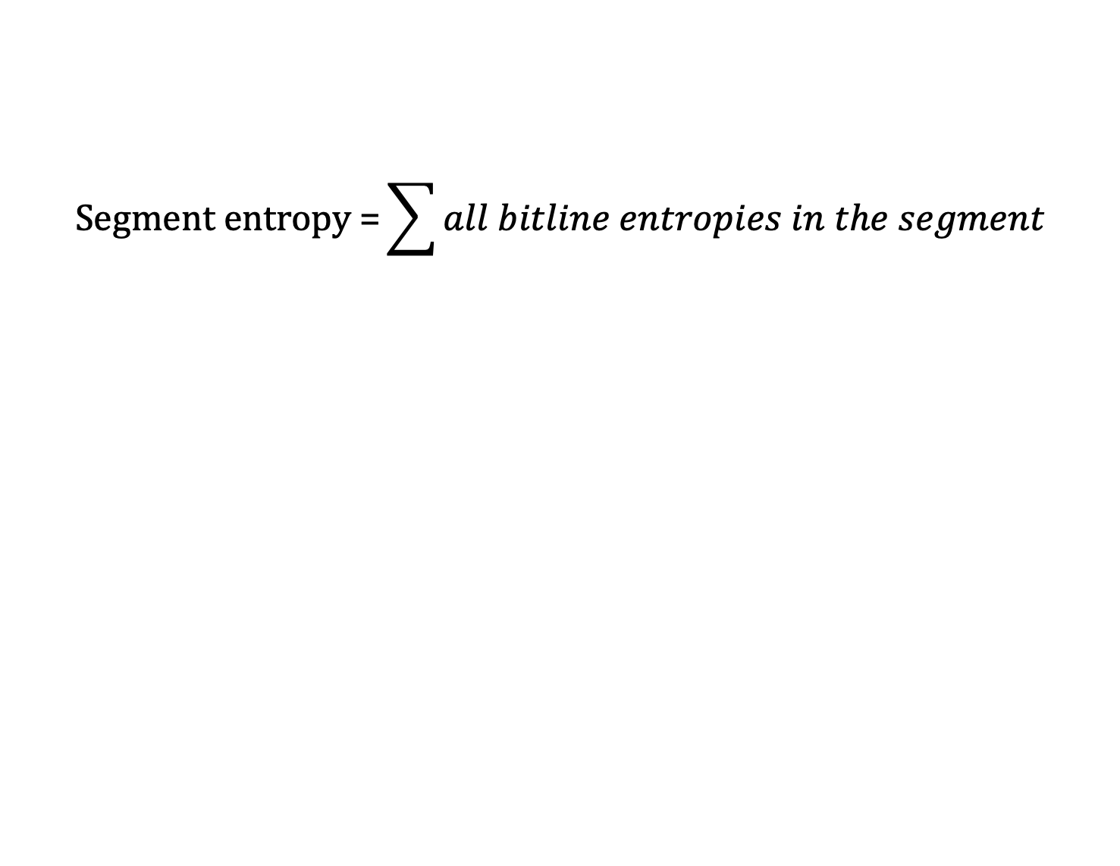
Spatial Distribution
$$\text{Segment} \text{entropy}\text{ =}\sum{all bitline entropies in the segment}$$
Segment entropy behavior is different for different modules

Slide 39
Spatial Distribution
$$\text{Segment} \text{entropy}\text{ =}\sum{all bitline entropies in the segment}$$
Entropy significantly increases towards the end of the DRAM bank

Slide 40
Takeaways: QUAC Entropy
We observe that entropy resulting from QUAC operations changes according to the
data pattern used in initialization
physical location of DRAM segments
attributed to:
systematic manufacturing process variation
design-induced variation

Slide 41
QUAC-TRNG’s Quality
Two experiments:
Collect bitstreams by repeatedly sampling bitlines after QUAC operations
1 Mb bitstreams
Post-processing: Von Neumann Corrector
Collect bitstreams using QUAC-TRNG
1 Gb bitstreams
Post-processing: SHA-256

Slide 42
QUAC-TRNG’s Quality
Two experiments:
Collect bitstreams by repeatedly sampling bitlines after QUAC operations
1 Mb bitstreams
Post-processing: Von Neumann Corrector
Collect bitstreams using QUAC-TRNG
1 Gb bitstreams
Post-processing: SHA-256
QUAC and QUAC-TRNG bitstreams pass all 15 NIST randomness tests

Slide 43
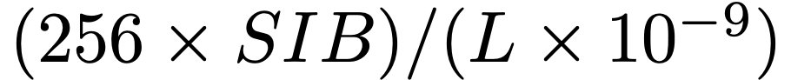
QUAC-TRNG Throughput Estimation
Estimate QUAC-TRNG’s throughput according to:
SIB: # of SHA Input Blocks in the highest-entropy segment
L: Latency of one QUAC operation in nanoseconds
bps

Slide 44
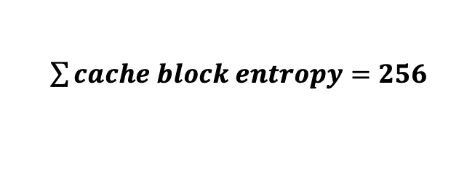
QUAC-TRNG Throughput Estimation
Estimate QUAC-TRNG’s throughput according to:
SIB: # of SHA Input Blocks in the highest-entropy segment
L: Latency of one QUAC operation in nanoseconds
bps
$\sum{cache block entropy}=256$
256-bit Entropy Blocks
1
2
3
4
1
2
3
4

Slide 45
QUAC-TRNG Throughput Estimation
Estimate QUAC-TRNG’s throughput according to:
SIB: # of SHA Input Blocks in the highest-entropy segment
L: Latency of one QUAC operation in nanoseconds
bps

Slide 46
QUAC-TRNG Throughput Estimation
Estimate QUAC-TRNG’s throughput according to:
SIB: # of SHA Input Blocks in the highest-entropy segment
L: Latency of one QUAC operation in nanoseconds
bps

Slide 47
QUAC-TRNG Configurations
1
One Bank
Use a single DRAM bank
Bank Group-Level Parallelism
2
BGP
Use four banks from different bank groups
RowClone + BGP
3
RC + BGP
Use in-DRAM copy to initialize DRAM rows and
use four banks from different bank groups
DRAM Subarray
Activate Source
Source Row
Precharge
Destination Row
Activate Destination
[Seshadri+ MICRO’13]
[Gao+ MICRO’19]

Slide 48
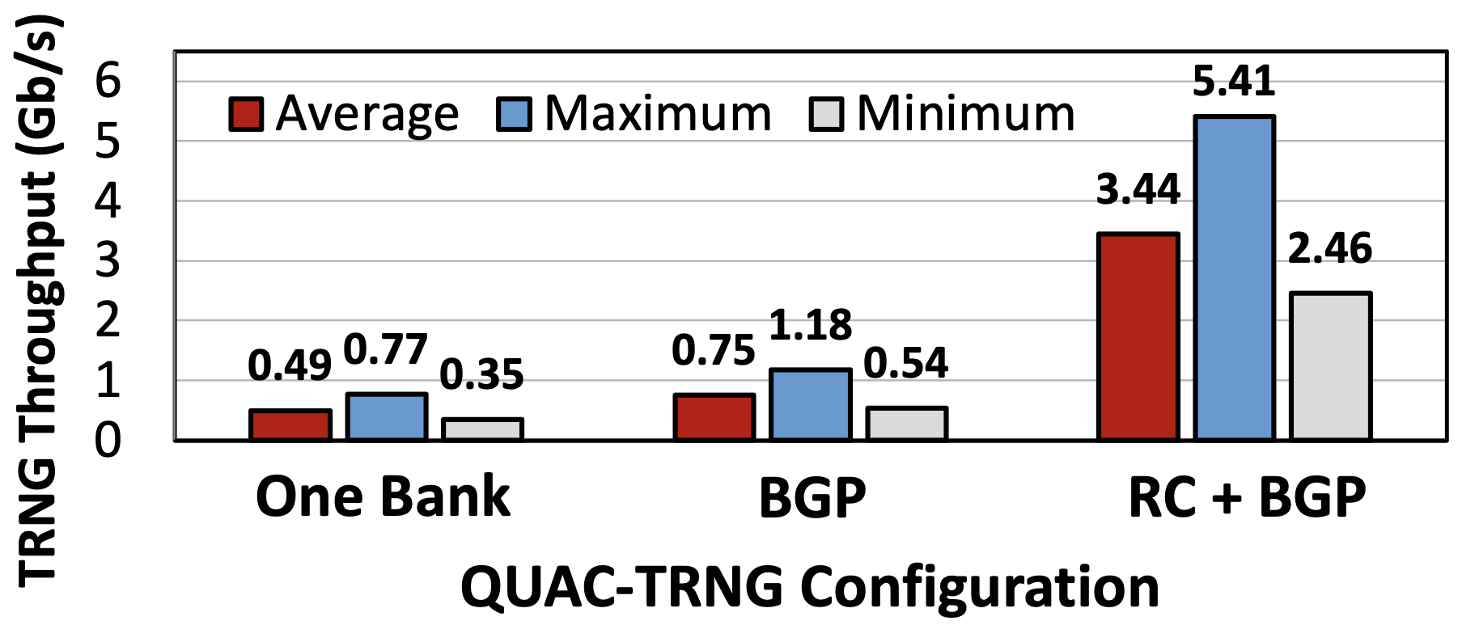
QUAC-TRNG Throughput
4.6X
Achieves 3.44 Gb/s throughput per DRAM channel on average across all modules
In-DRAM initialization greatly improves throughput

Slide 49
QUAC-TRNG vs State-Of-The-Art
High-throughput DRAM-based TRNGs:
D-RaNGe: Activation latency failures
Talukder et. al: Precharge latency failures
Calculate throughput by tightly scheduling the DDR4 commands required to induce failures
Evaluate two versions of these past two works:
Base: As proposed
Enhanced (Fair): Throughput-optimized (SHA-256)
Assume four-channel DDR4 memory
[Kim+, HPCA’19]
[Talukder+, IEEE Access 2019]

Slide 50
QUAC-TRNG vs State-Of-The-Art
Outperforms best prior DRAM-based TRNG (i) “base” by 15.08x at 2.4 GT/s
(ii) “enhanced” by 2.03x at 12 GT/s

Slide 51
More in the Paper
NIST randomness tests results
Throughput & latency comparison against four other DRAM-based TRNGs
System Integration
How QUAC-TRNG can be implemented in real systems
System performance study
QUAC-TRNG’s throughput with concurrently running applications
Area overhead: 0.04% of a contemporary CPU (7 nm)
Memory overhead: 0.002% of an 8 GiB DRAM module
Sensitivity Analysis
Effect of temperature on QUAC’s entropy
Entropy changes with temperature
Time dependence study
Entropy remains stable for at least up to a month

Slide 52
Executive Summary
Motivation: DRAM-based true random number generators (TRNGs) provide true random numbers at low cost on a wide range of computing systems
Problem: Prior DRAM-based TRNGs are slow:
Based on fundamentally slow processes → high latency
Cannot effectively harness entropy from DRAM rows → low throughput
Goal: Develop a high-throughput and low-latency TRNG that uses commodity DRAM devices
Key Observation: Carefully engineered sequence of DRAM commands can activate four DRAM rows → QUadruple ACtivation (QUAC)
Key Idea: Use QUAC to activate DRAM rows that are initialized with conflicting data (e.g., two ‘1’s and two ‘0’s) to generate random values
QUAC-TRNG: DRAM-based TRNG that generates true random numbers at high-throughput and low-latency by repeatedly performing QUAC operations
Results: We evaluate QUAC-TRNG using 136 real DDR4 chips
5.4 Gb/s maximum (3.4 Gb/s average) TRNG throughput per DRAM channel
QUAC-TRNG has low TRNG latency: 256-bit RN in 274 ns
Outperforms existing DRAM-based TRNGs by 15.08x (base), and 1.41x (enhanced)
QUAC-TRNG passes all 15 NIST randomness tests

Slide 53
QUAC-TRNG High-Throughput True Random Number Generation Using Quadruple Row Activation in Real DRAM Chips
Ataberk Olgun
Minesh Patel A. Giray Yağlıkçı Haocong Luo
Jeremie S. Kim F. Nisa Bostancı Nandita Vijaykumar
Oğuz Ergin Onur Mutlu

Slide 54
BACKUP SLIDES

Slide 55
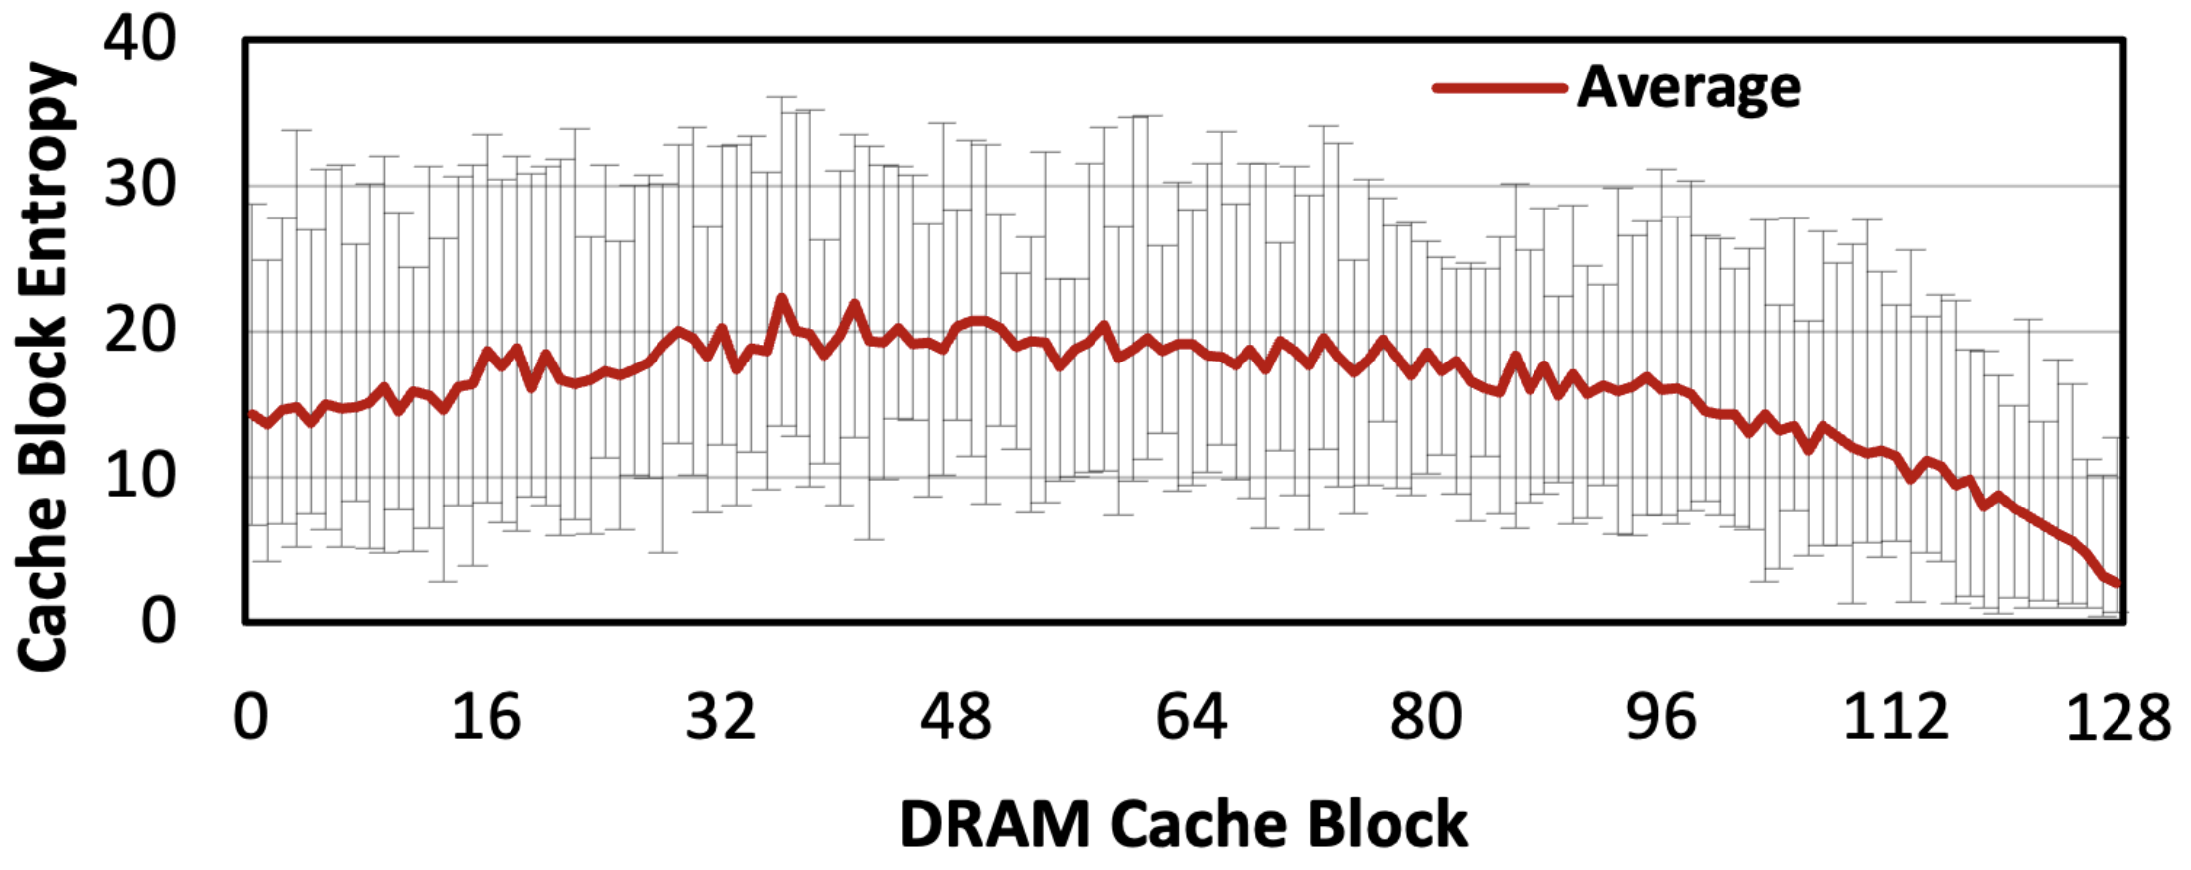
Spatial Distribution
Cache block entropy is the highest around the middle of the DRAM segment

Slide 56
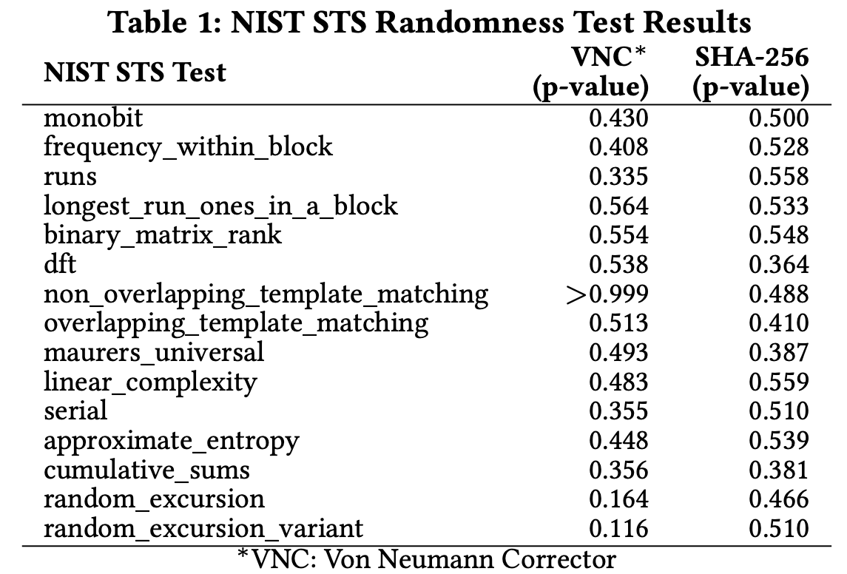
NIST Results

Slide 57
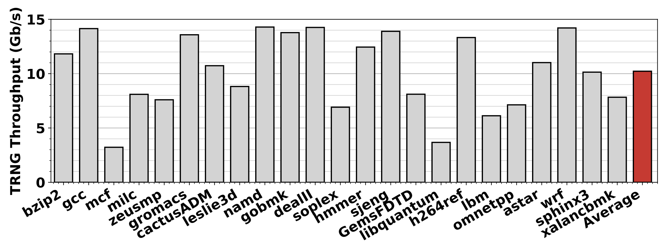
System Performance Study
The maximum throughput QUAC-TRNG provides without reducing the total off-chip memory bandwidth
Ramulator: 3.2 GHz core, four-channel DDR4 memory
QUAC-TRNG achieves 74.13% of the empirical average throughput

Slide 58
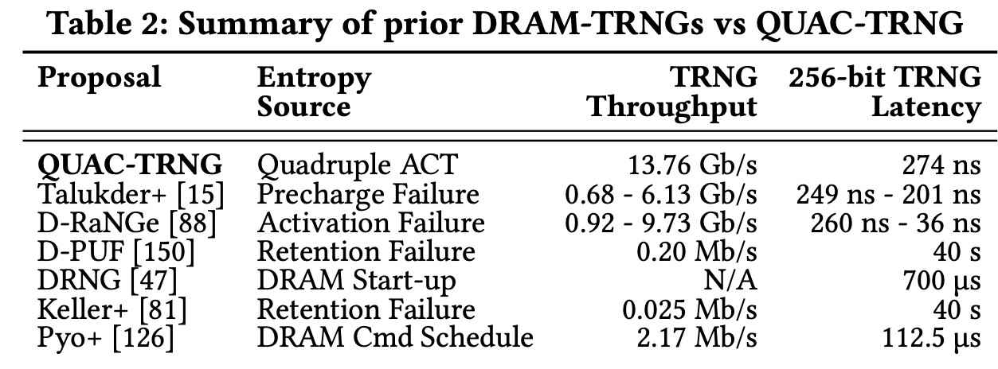
Throughput & Latency Comparison

Slide 59
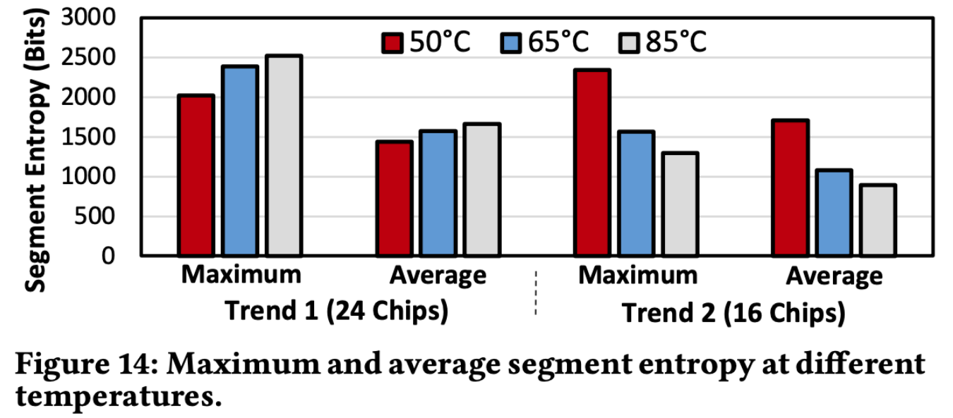
Temperature Dependence

Slide 60
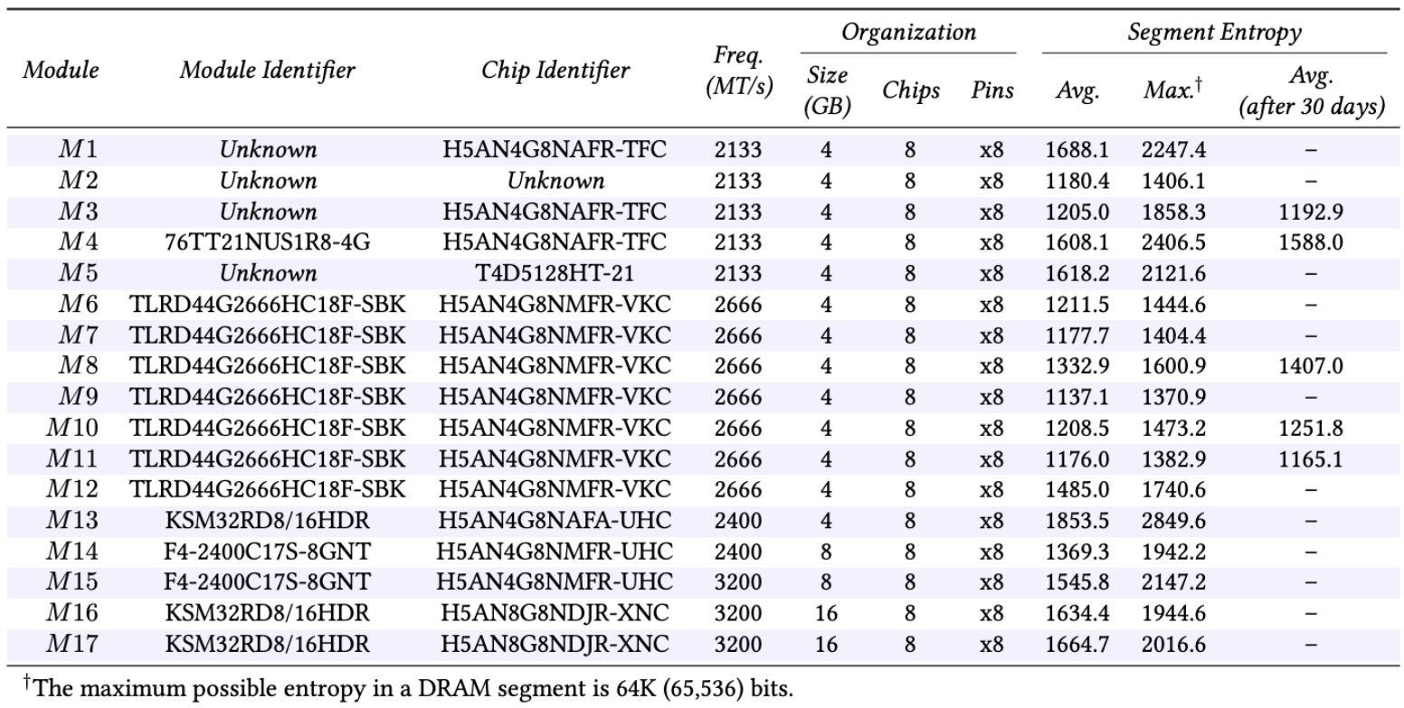
DDR4 Modules

